Slide 1
Machine Learning – Classification
Michael Claudius, Associate Professor, Roskilde

Slide 2
What is Machine Learning Classification
Classification: Predict classes; e.g. digits, letters, faces
Correct prediction: Positive
Wrong prediction: Negative
Regression: Predict values; e.g. slope 9.44, intersection 44..85
Both need a ML algorithms!

Slide 3
Machine Learning Classification
Its about making data ready and to find the best classification model
1. Explore and prepare data
Handle missing feature instances -> How to fix it
2. Metric
Defining the ML Classification type
3. Train models on training set
Training and Evaluating on the Training Set
4. Analyze the models by performance measures:
Cross validation
Confusion Matrix
Precision – Recall
ROC-curve
5. Choose the best model and launch
A detailed checklist is given on ML Management Checklist (PDF)
Remember always adapt the order and the checklist to your needs

Slide 4
Classification Types
Binary: One class (e.g. digit 5) and one Not-class (Not a digit 5)
Multiclass: More classes (e.g. 10 digits: 0, 1, 2, .. . . 9)
Multilabel: One class has several labels
e.g. larger than 7, odd? (e.g. is 5 larger than 7, is 5 odd?)
Multioutput: Each label has 2 or more classes
e.g. 10 digits: 0, 1, 2, .. . . 9, color: blue, green red….
Picture class background: city, country-side, forest. Class foreground animal: dog, cat, bird

Slide 5
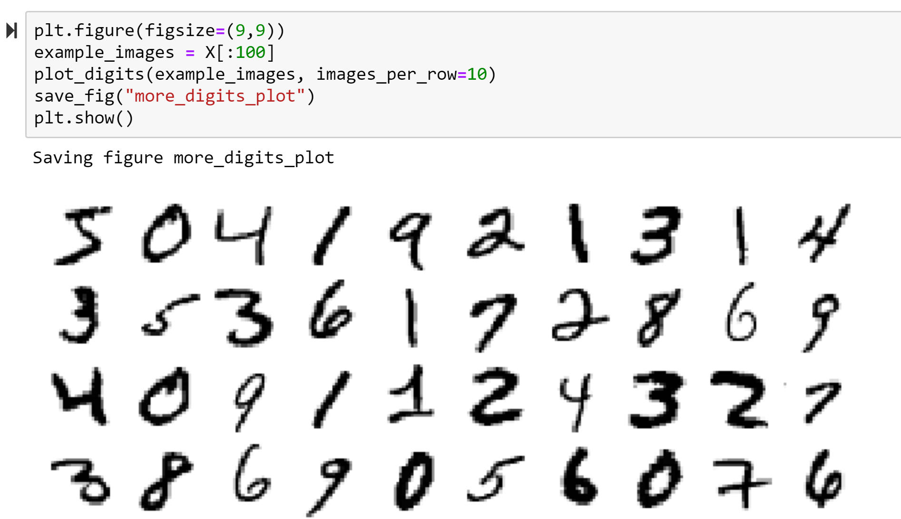
The Context: Mnist-784 Data Set
Pictures of 70.000 handwritten digits
One picture 28x28 pixel
Shuffled already: training set first 60.000 test set last 10.000 pictures
Download form openlm.org/d/554

Slide 6
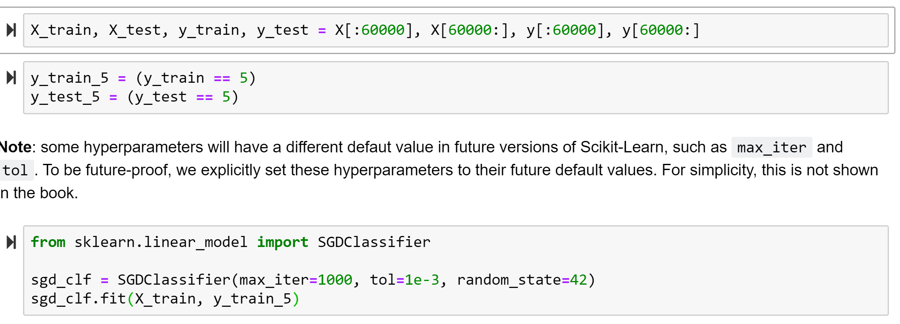
Classification Metrics
Binary 5 or Not-5
Classifiers: Stochastic Gradient Descent (SGD) and Random Forest

Slide 7
Performance Measures
Cross Validation
Confusion Matrix
Precision – Recall
ROC-curve and AUC

Slide 8
Performance Measure: Cross Validation
Cross validation with scoring accuracy and using 3 folds
Predicting accuracy for 5: >95%
Predicting accuracy for Not-5 > 90%
Impressing or NOT?
Actually NOT. Calm down. Remember 90% of numbers are Not-5!!
Conclusion: Cross validation not the right performance measure for classification

Slide 9
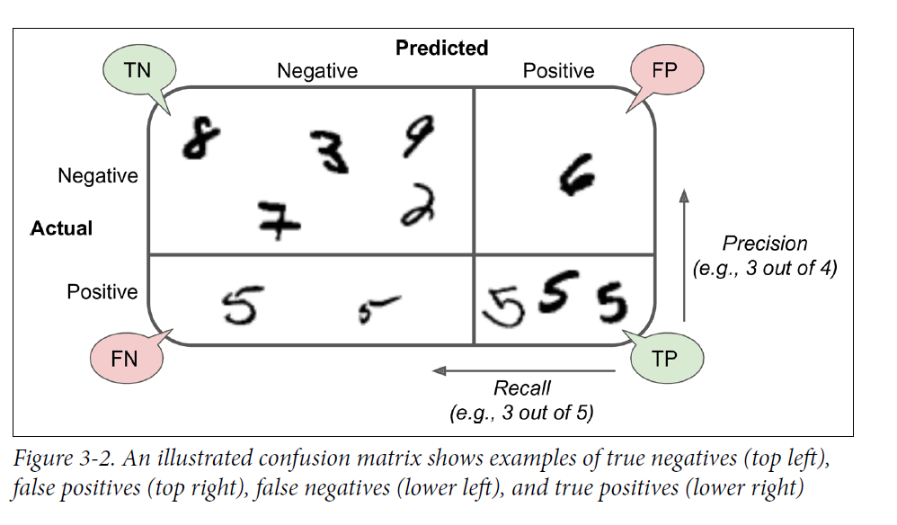
Performance Measure: Confusion Matrix
Divides data into:
Actual Positive and Actual Negative
Predicted Positive and Predicted Negative
TN: True Negative, predicted negative and it is actual negative (Not-5)
FN: False Negative, predicted negative but the digit is actual positive (5)
TP: True Positive, predicted positive and the digit is actual positive (5)
FP: False Positive, predicted positive but the digit is actual negative (Not-5)

Slide 10
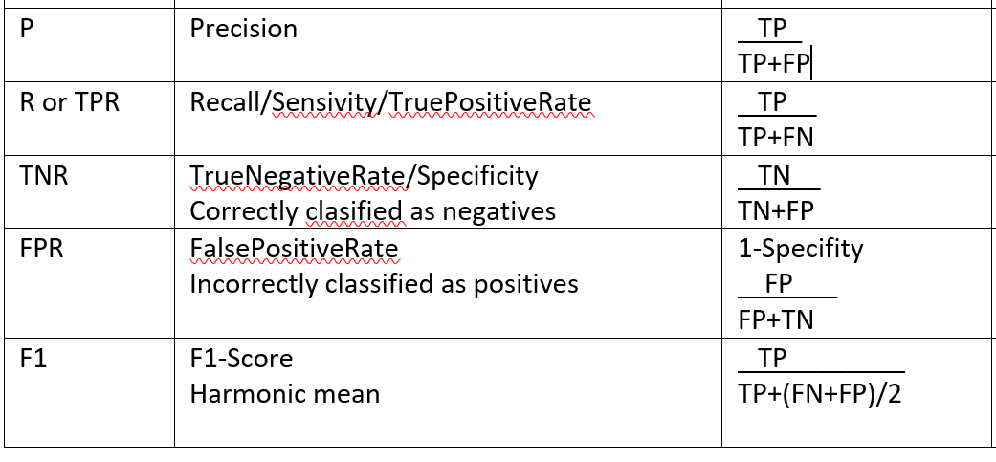
Confusion Matrix: Concise Metrics
Precision: Accuracy of positive predictions
Recall: Accuracy of positive actuals, (ratio of positives correctly detected)
F1: Harmonic mean of Precision and Recall
Confused About Confusion Matrix and Metrics . . . . LOL . . .
Don’t worry lets go straight to an assignment: Classification Chapter 3 Questions and solve it in 20 minutes !

Slide 11
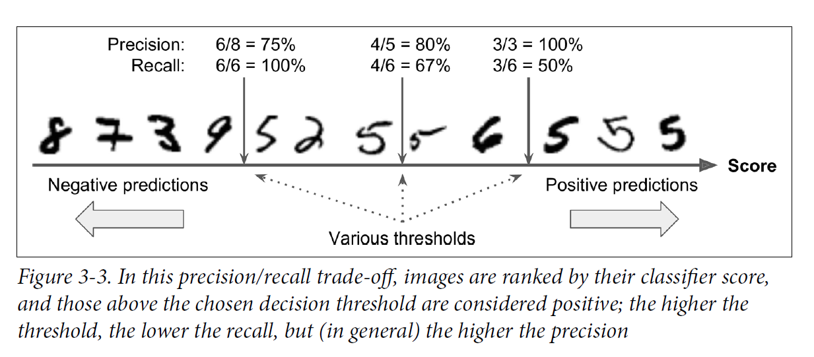
Precision/Recall Tradeoff: Example
Wanted: High Precision and High Recall !
Not possible !!
SGDClassifier computes a score based on a decision function based on a “threshold” value
Confused About Confusion Matrix and Metrics . . . . LOL . . .
Depending on the “threshold “ high precision and low recall or opposite

Slide 12
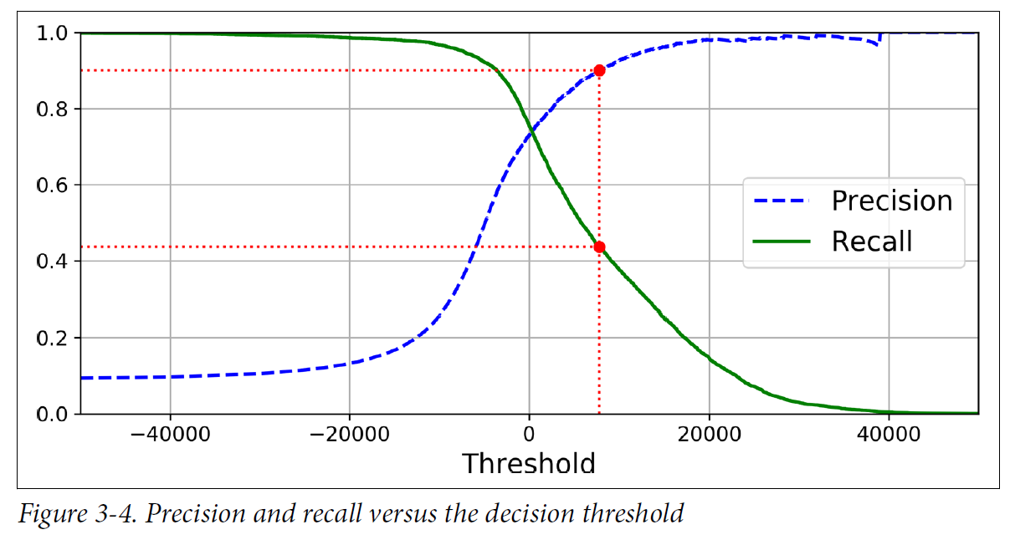
Precision/Recall Tradeoff: Curve
Want 0.90 (90%) precision. Select Threshold = 8.000. Gets Recall = 0.43 (43%)
Depending on the “Threshold “ high precision and low recall or opposite

Slide 13
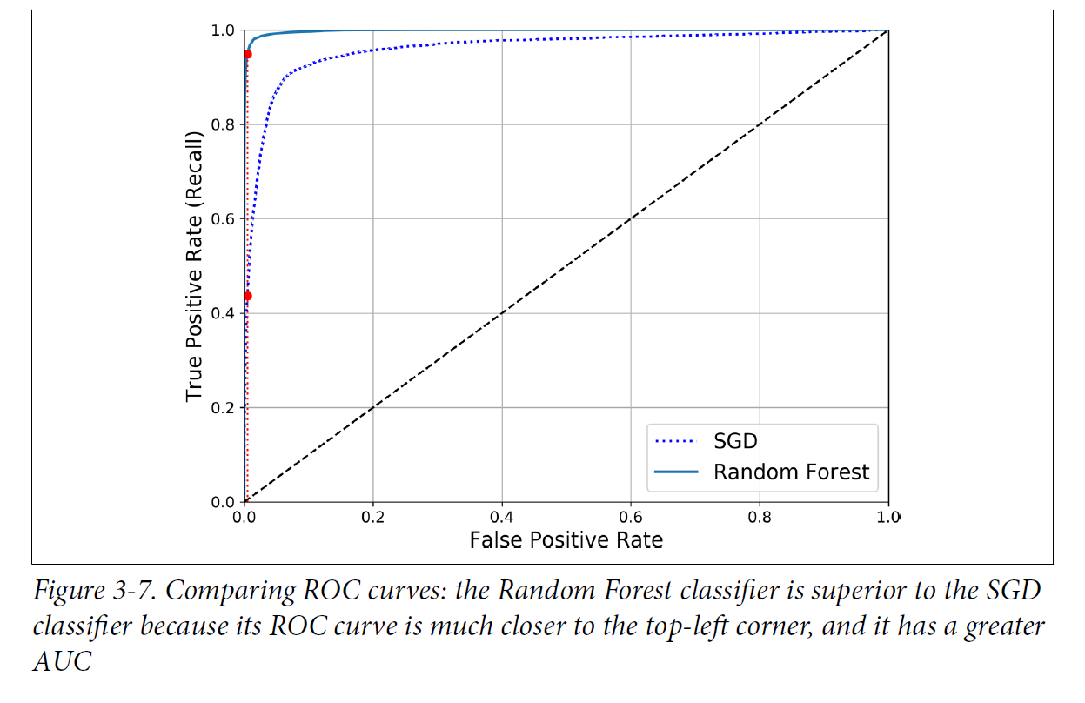
ROC: Receiver Operating Classifier
The ROC curve plots True Positive Rate against False Positive Rate
for many possible threshold values
AUC: Area Under Curve
Objectives: Close to top left corner and AUC close to 1.0
And the Winner is Random Forest! Precision 0.99, Recall 86.6%, AUC 0.998

Slide 14
Precision/Recall (PR) vs. ROC
Normally ROC
Precision/recall when positive class is seldom
Precision/recall when False Positives (FP) are important

Slide 15
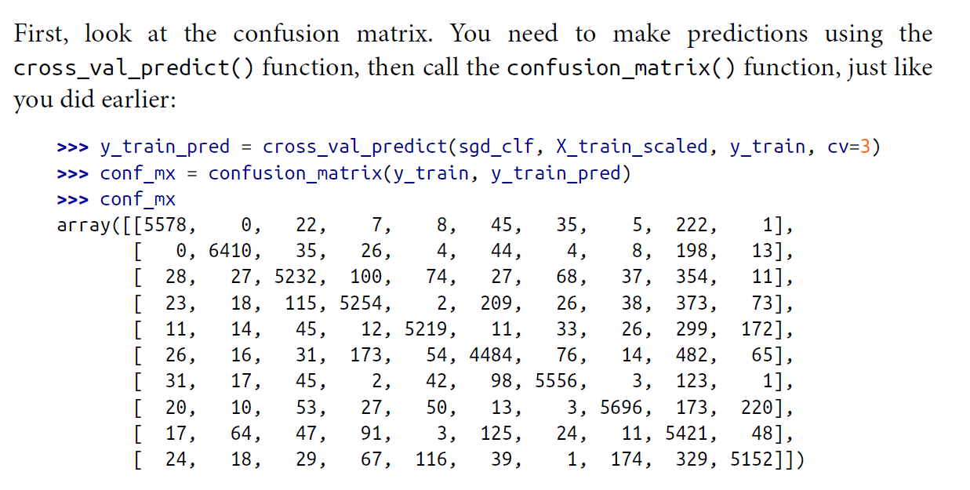
Multi Class: ConfusionMatrix
2 or more classes, e.g. digits 0, 1, 2 . . . 9
Use StandardScaler on pictures
Observe: Many False-8
Observe: False-5 as 3, False 3 as 5

Slide 16
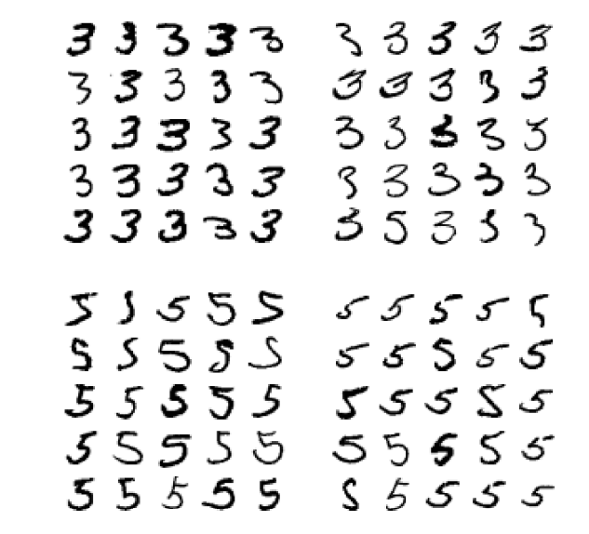
Multi Class: Errors
Left column classified as 3
Right column classified as 5
Conclusion Classifier sensitive to image rotation and shifting

Slide 17
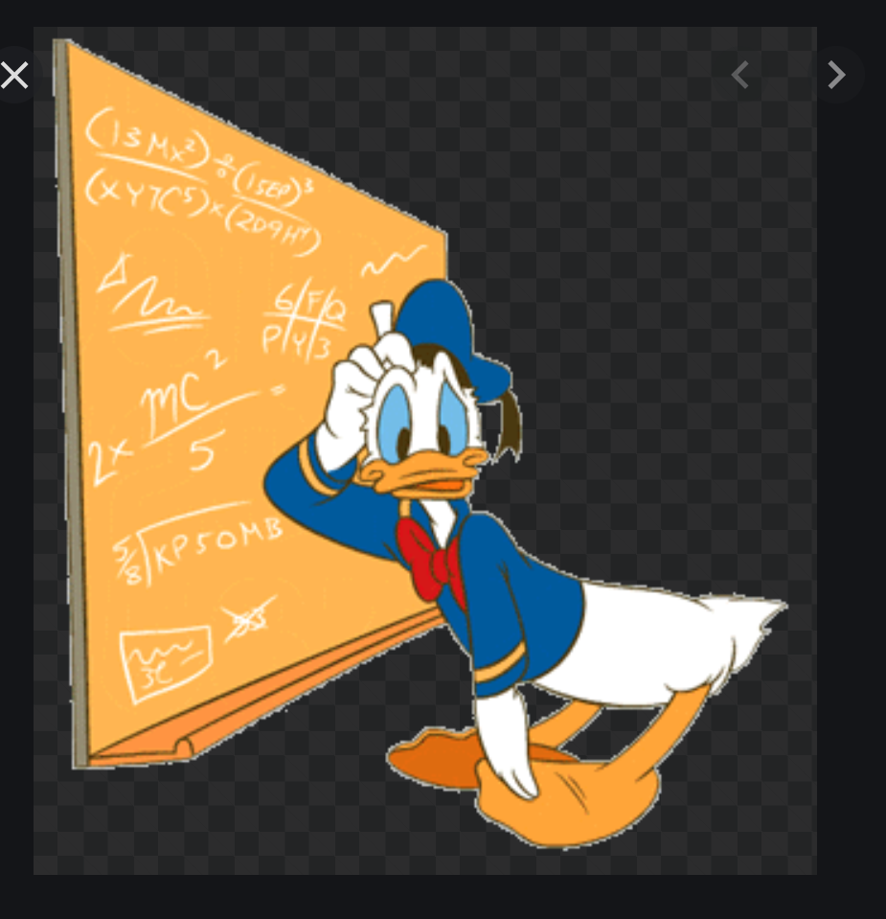
Exercise
It is time for discussing classification and exploring the MNIST-data set
Classfication MNIST Exercise

